Slide 1
NATIONAL INDIAN EDUCATION ASSOCIATION

Slide 2
NIEA CELEBRATES NATIONAL POETRY MONTH Presenters: KURRINN ABRAMS NIEA Education Specialist CASIE WISE CUTTING EDGEucation Education Consultant
Notes:
Kurrinn introduces and does housekeeping

Slide 3
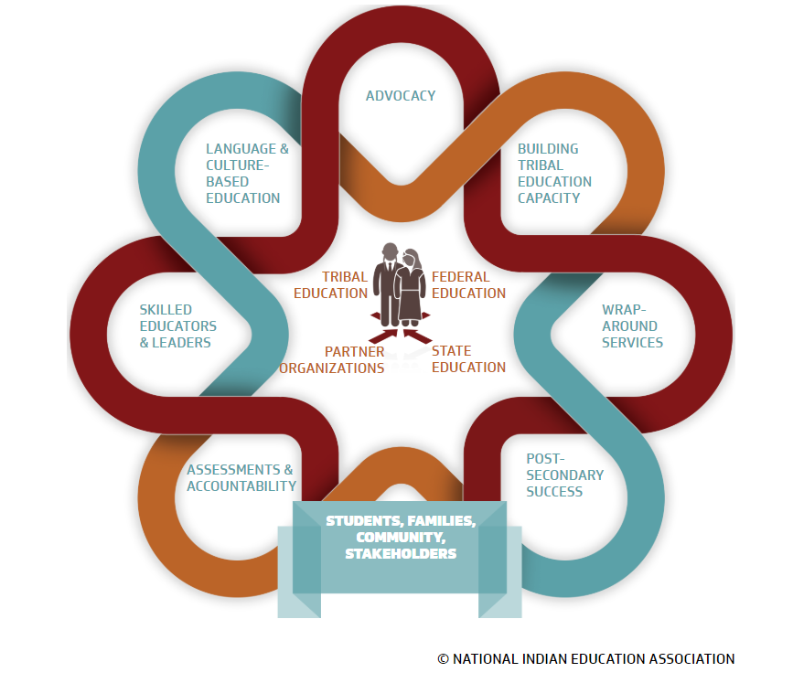
WHO IS NIEA?
OUR MISSION
The National Indian Education Association advances comprehensive, culture-based educational opportunities for American Indians, Alaska Natives, and Native Hawaiians.
Notes:
Kurrinn

Slide 4
APRIL: NATIONAL POETRY MONTH
“Bless the poets, the workers for justice, the dancers of ceremony, the singers of heartache, the visionaries, all makers and carriers of fresh meaning—We will all make it through, despite politics and wars, despite failures and misunderstandings. There is only love.”
― Joy Harjo, Conflict Resolution for Holy Beings: Poems
Notes:
Kurrinn

Slide 5
AGENDA
Spotlight: Native Poets & Poems
Celebrating Poetry Month
Poetry as Voice
Digital Poetry Resources
Notes:
Kurrinn

Slide 6
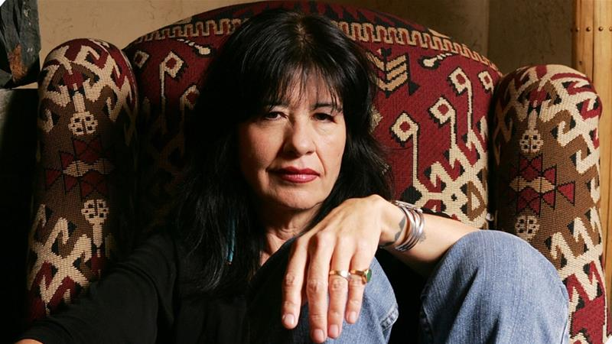
2019 US POET LAUREATE: JOY HARJO
Member of Muskogee Creek Nation
First ever Native American Poet Laureate
The nation’s 23rd Poet Laureate since the title was created in 1985
She is one of six women to be named Poet Laureate
Joy Harjo [File: Carlo Allegri/Getty Images]
Notes:
She was announced as the US Poet Laureate in June of 2019. She is an accomplished poet and author with many published poetry books and short stories. As a Poet Laureate for the US she presents her poetry and presentations publicly. As a poet laurate, Harjo is to use her role to spread an understanding of poetry’s importance and cultural value as well as represent the art of poetry nationally.

Slide 7
WHAT DOES IT MEAN TO BE POET LAUREATE?
Notes:
After accepting the honor of poet laureate, Harjo sat down for her official interview. This is a short clip as she explains why this role is such an honor for her, especially being the first Native American poet ever given this title.

Slide 8
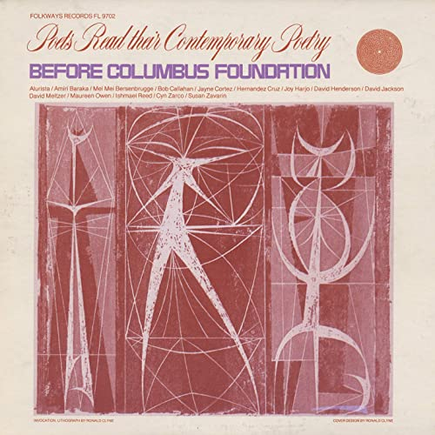
JOY HARJO: I AM A DANGEROUS WOMAN
“I am a Dangerous Woman”
From the album
Poets Read Their Contemporary Poetry: Before Columbus Foundation
Notes:
Casie
https://www.youtube.com/watch?reload=9&v=AoXMHf3Pzfg Stop at 1:05

Slide 9
STOP & JOT
Describe in one word how that poem made you feel.
Take a moment to enter your response
into the Question Box.
Notes:
Kurrinn

Slide 10
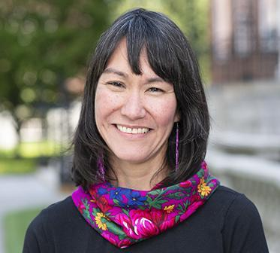
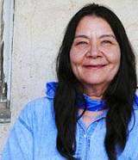
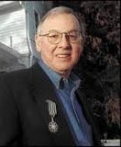
Published Native Poets
Joseph Bruchac: contemporary Native American author; Well-known for children’s and young adult short stories, picture books, and poetry
Louise Erdrich: well-known Native American author from Minnesota; has Native American bookstore
Paula Gunn Allen was a contemporary Laguna Pueblo author who also wrote through a Feminist lens.
Joan Naviyuk Kane is an Inupiaq poet from Alaska. Her latest poetry book is Milk Black Carbon with some poems in the Inupiaq language.
Leslie Marmon Silko: Laguna Pueblo poet/novelist, key figure of Native Renaissance
James Welch: well-known Blackfoot author. Wrote about the American West. Considered founding father of the Native Renaissance
N.Scott Momaday: contemporary Native American author; The House Made of Dawn is an American classic.
Notes:
Casie

Slide 11
SOME OBJECTIONS TO POETRY
It’s too hard for children (ME) to understand…
It’s not really popular anymore….
It doesn’t fit in my subject….
I DON’T KNOW HOW TO WRITE IT….
I just don’t have time to teach it ….
Notes:
Casie

Slide 12
CONNECTING STUDENTS TO POETRY
-Utilize local, Native, and culturally relevant authors
-Connect current experience to modern and historical poets’ experiences
-Share personal poems and allow students safe space to share theirs
-Promote poetry as a voice of empowerment and advocacy
-Model the methods and inspiration for writing poetry
-Share poetry as an understanding of human place in history
-Share poems across peoples’ historical experience (slavery, displacement, war, journeys, philosophies, etc.)
-Study archetypes across different cultures/authors/time periods
Notes:
Casie

Slide 13
POETRY: A LITERACY CONTINUUM
Poetry for making meaning, self-expression, social justice, empathy, historical significance
Poetry for Structure, Response to reading, Composition, and Meaning
K-2
3-5
6-8
9-12
Poetry for Language Skills, Entertainment, Story Elements, and Information
Poetry for Phonics, Rhythm, Engagement, and Language Skills
Connecting Poetry to Rhythm/Music------------------------ Poetry as a Convention Breaker
Notes:
Casie

Slide 14
BENEFITS OF USING POETRY FOR INSTRUCTION
CTITICAL THINKING
LANGUAGE SKILLS
IDENTITY
WRITING SKILLS
Adapts across content areas
Increases cognitive development
Triggers memory through patterns and imagery
Builds student awareness of language and language manipulation
K-2 uses for teaching phonics and content
Explores various perspectives
Allows expression without judgement
Empowers voice and advocacy
Connects to all major writing types
Gives students freedom to play with language and writing (invention)
Notes:
Casie

Slide 15
TEACHING SKILLS THROUGH POETRY
Figurative language
Multiple word meanings
Theme
Voice
Foundational skills (phonics, patterns, rhyme, etc.)
Writing from sources
Literary analysis
Criticism
Synthesis
Notes:
Kurrinn

Slide 16
COMMON THEMES ACROSS NATIVE POETRY
Traditional values (shared ownership, family, food customs, gift-giving, etc.)
Perceived and enacted role of Native Americans in modern society
Marginalization
Paternalism
Discrimination
Rite of passage (coming of age)
Options: assimilation, annihilation, or revolution
Connections with spiritual and natural world
Notes:
Kurrinn

Slide 17
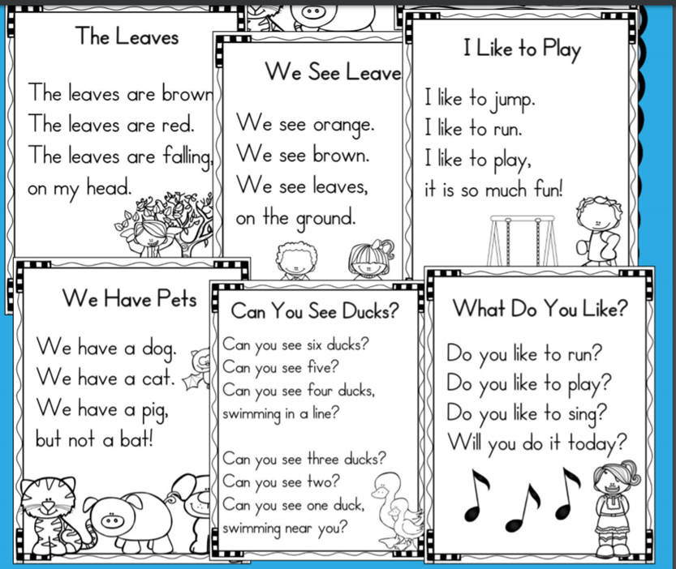
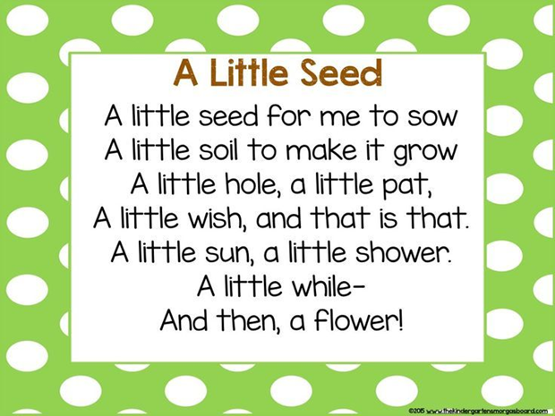
POETRY & FOUNDATIONAL SKILLS
Sight Words Knowledge Building/Rhyme
Notes:
Kurrinn

Slide 18
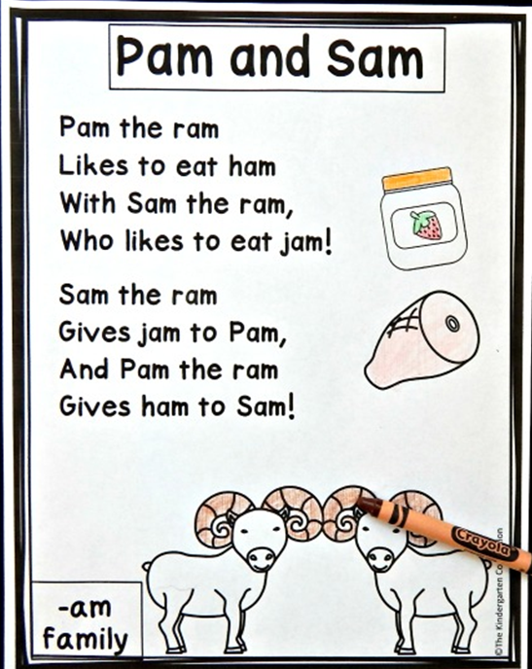
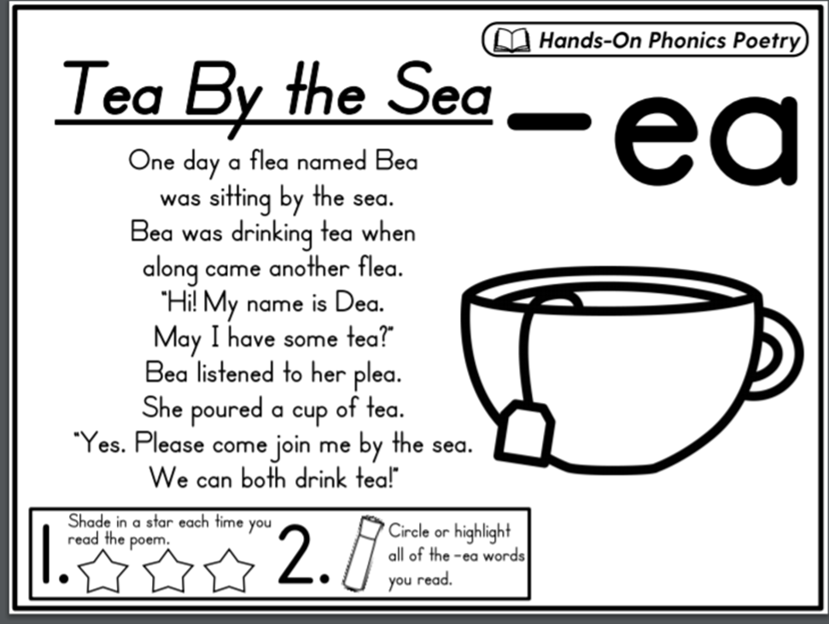
POETRY & PHONICS
CVC Patterns Digraphs
Notes:
Kurrinn

Slide 19
IDENTITY POEM
I AM……
Lesson Plan for writing Identity Poems (https://www.adl.org/education/educator-resources/lesson-plans/who-am-i-identity-poems)
Notes:
1 minute
Kurrinn
This resource includes links to poetry sites for children

Slide 20
ACROSTIC POEMS
Lesson Plan for writing Acrostic Poems http://teacher.scholastic.com/lessonrepro/lessonplans/profbooks/acrosticwriting.pdf
Studylib.net
Notes:
1 minute
Casie

Slide 21
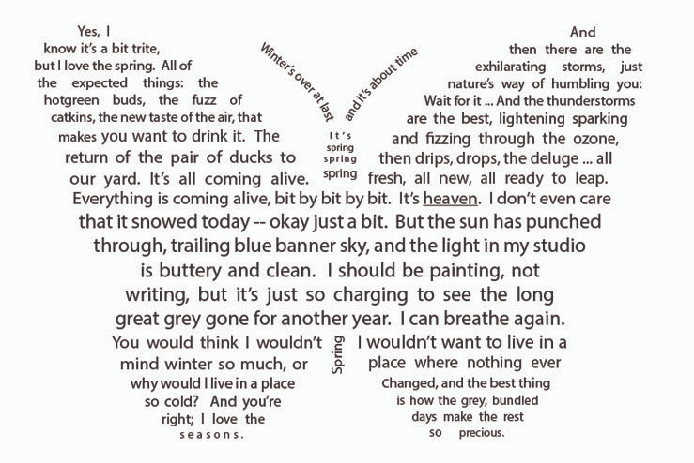
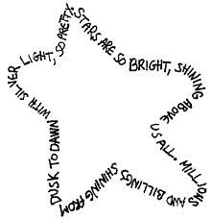
SHAPE POEMS
Lesson Plan for writing Shape Poems
http://www.readwritethink.org/parent-afterschool-resources/activities-projects/write-theme-poems-30173.html?main-tab=1#tabs
https://translunarythings.wordpress.com/2015/04/09/a-shape-for-spring/
Pintrest.com
Notes:
1 minute
Owner: Kurrinn
The job board, housed on the website, provides job seekers with the ability to search through jobs across the country that specifically serve Native students.
The jobs posted represent individual schools and school districts, as well as tribally-controlled, BIE, and charter schools.
When visiting the job board, applicants see a list of open positions organized by grade band (ECE, elementary, etc.)
Users can sort by grand band or location, or even by subject area.
When a potential applicant clicks on a link to a job, the job description appears highlighting what is unique about that specific position and school, and provides guidance for applying.
With each job posting, there is a linked application when applicants can submit their information directly through out site.
Once someone applies, principals or hiring managers can log into the system and see who has applied to their position(s) and who is available to interview.
We also work closely with schools to ensure the job board is maintained and that all postings are up-to-date.
Through regular outreach, we help schools leaders and hiring managers remember to update their postings, or we can provide direct support and update them as needed.

Slide 22
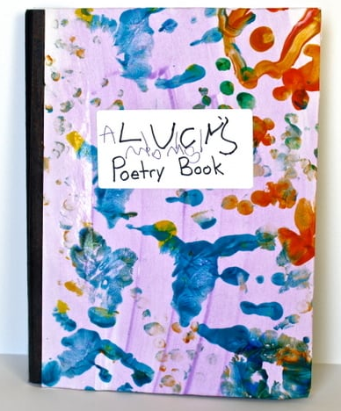
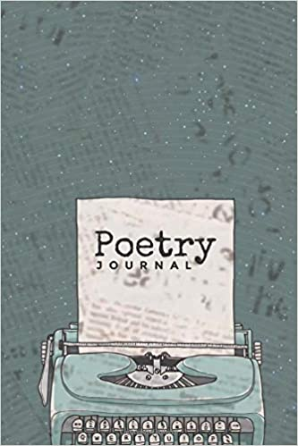
POETIC JOURNAL
Poetry journals can be used to jot down poems or thoughts for life experience
OR
Poetry journals can include reflections about poems you read.
https://buggyandbuddy.com/poetry-journals-poetry-for-children/
Amazon.com
Notes:
1 minute
Owner: Kurrinn
It’s difficult to express what we feel in spoken form so sometimes I need to jot down my thoughts in poetic form. Sometimes I will return to those thoughts and create a longer poem. And sometimes I just want to forget.

Slide 23
STOP & JOT
Share your own examples of how you write or teach poetry.
Take a moment to enter your response
into the Question Box.
Notes:
Kurrinn

Slide 24
USING POETRY TO COPE WITH CRISIS
Poetry can be a space of freedom.
Poetry is not bound by rules or structure and can feel less constrained.
It provides a way to freely release feelings.
Poetry is imaginative and can offer moments of escape.
Poetry is a space of unity and communication.
In a short space of writing, a person can enter another person’s world and feel connected.
Poetry gives a voice to the human experience in a way that music does.
Poetry has healing qualities as we find that others feel the way we do.
Poetry remembers.
Poetry is a way to preserve the events in our past, present, and future.
It is a space to walk away from something, only to return when it needs to be remembered.
Poetry makes pain and joy tangible.
Notes:
Casie

Slide 25
ONLINE POETRY RESOURCES
1
Poets.org
https://poets.org/native-american-heritage-month (Collection of Native poetry for adults and students)
Nativeamericanlit.com
http://nativeamericanlit.com/ (Information on the authors of the Native American Renaissance)
PoetryFoundation.org https://www.poetryfoundation.org/collections/144560/native-american-poetry-and-culture(Collection of Native poems and articles on the Native experience)
Childrens.poetryarchive.org
https://childrens.poetryarchive.org/ (Non-Native collection of children’s poems and read alouds)
2
3
4
Notes:
Kurrinn

Slide 26
TEACHING POETRY REMOTELY
The Poetry Foundation offers Online Learning Resources for teaching poetry to students ages 4-18 https://www.poetryfoundation.org/collections/153058/online-learning-resources
The National Council of Teachers of English (NCTE) offers a list of digital apps or tools for creating poetry https://ncte.org/blog/2016/04/online-tools-apps-poetry/
Poets.org has a page dedicated to online poetry teaching resources https://poets.org/materials-teachers
1
2
3
Notes:
Kurrinn

Slide 27
TIPS FOR TEACHING POETRY ONLINE
Less is more
Shorter tasks and reading selections
Focus on relevant, interesting, and optimistic poems
Focus Skills
Select a targeted purpose or theme for students as they read/respond
Provide Support
Consider definitions, supporting videos, voice overs, and additional notes
Model by text, video, or annotated images
Demonstrate and share rather than “teach”
Offer graphic organizers or strategies (SIFT, SLAM, SOAPS, ect)
CONNECTING SCHOOLS WITH HIGHLY QUALIFIED EDUCATORS
Notes:
Kurrinn

Slide 28
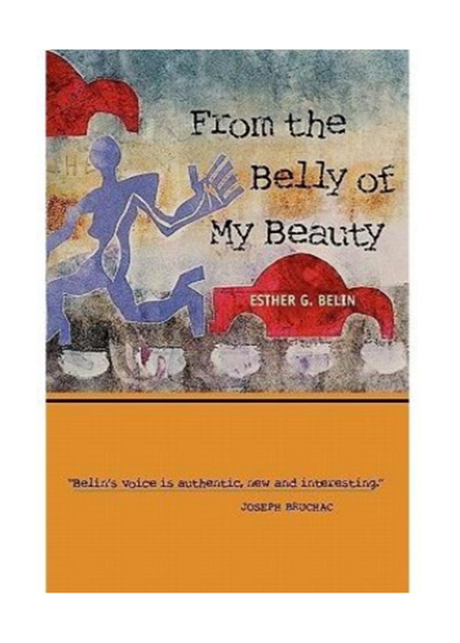
FEATURED POETS: Esther G. Belin (Diné/Navajo)
“Euro-American Womanhood Ceremony”
From the Belly of my Beauty
Notes:
Casie

Slide 29
FEATURED POETS: by Chrystos (Minominee)
“I am Not Your Princess”
#NotYourPrincess
Notes:
Casie

Slide 30
STOP & JOT
Share your favorite poems and/or poets.
Take a moment to enter your response
into the Question Box.
Notes:
Kurrinn

Slide 31
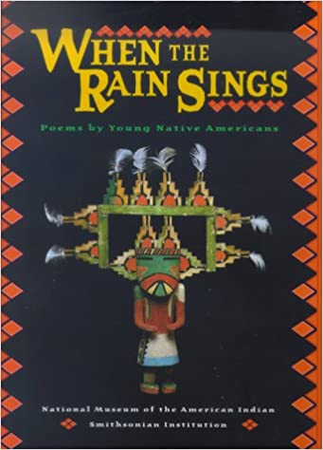
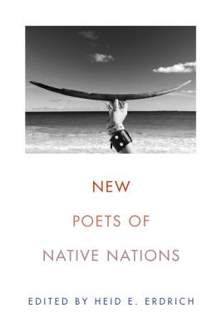
RECOMMENDED NATIVE POETRY COLLECTIONS
Notes:
Kurrinn

Slide 32
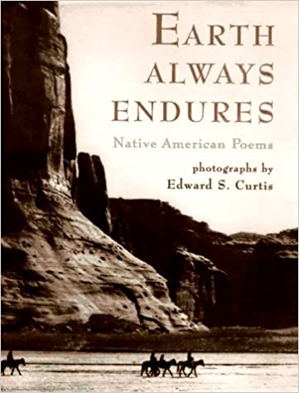
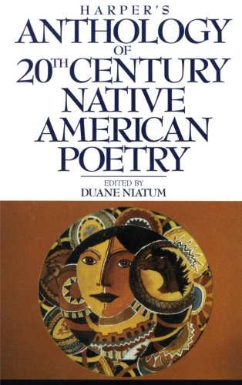
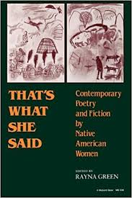
RECOMMENDED NATIVE POETRY COLLECTIONS
Notes:
Kurrinn

Slide 33
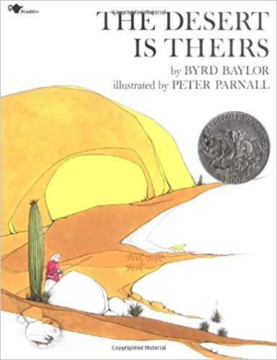
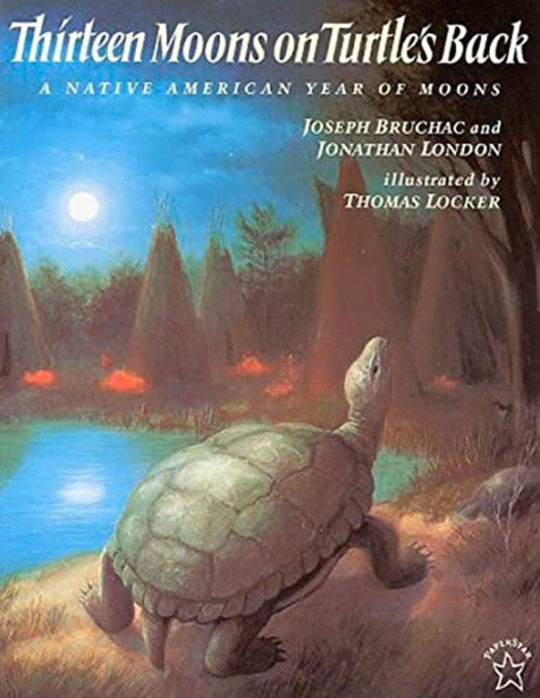
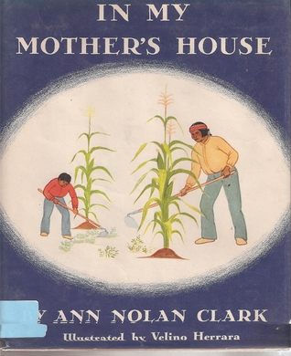
NATIVE POETRY BOOKS FOR CHILDREN
Notes:
Kurrinn

Slide 34
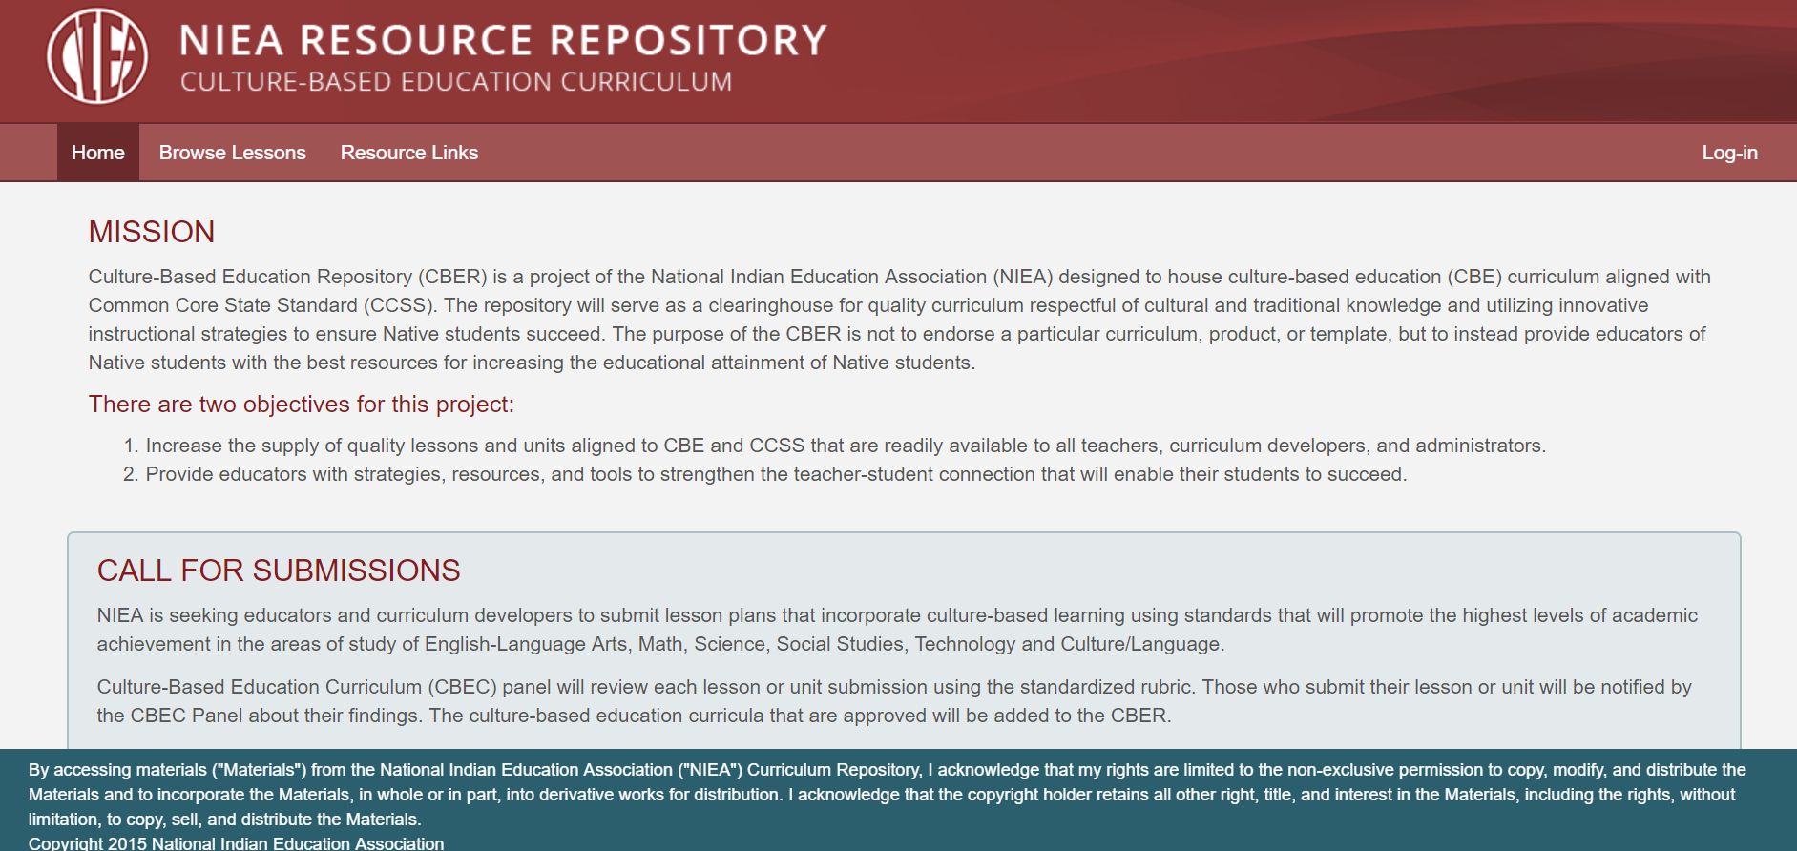
Culture Resource Repository
Notes:
Kurrinn

Slide 35
UPCOMING RESOURCES
NIEA & IllumiNative Call for Submissions
We are inviting submissions of student-centered lesson plans, tasks, activities and materials for online use from educators and communities across Indian Country who are interested in assisting our collective organizations to support our educators, parents, families, communities, and students during this new era of virtual and home learning.
Please email the following materials to: teachnative@niea.org
by April 19, 2020 at 11:59pm EST.
• All Lesson Plans, Activities, Tasks, and Materials you wish to submit
• Bio and Resume/CV
Notes:
Kurrinn

Slide 36
NIEA’S 51ST Annual Convention October 7-10, 2020 - Albuquerque, NM https://www.niea.org/2020-convention-call-for-presentations
Notes:
HOLDER SLIDE

Slide 37
CONTACT US
www.niea.org | 202-544-7290
@WereNIEA NIEAFanPage @niea1969

